Slide 1
2018 StackOverFlow Survey Analysis
Matthew Sah
Kashyap Balasubramanian
Huangwei Ding

Slide 2






Salary
Skills
Gender
Age
Education

Slide 3
OpenSource
FormalEducation
UndergradMajor
DevType
YearsCoding
Age
Gender
platform
ide
os
languageworkedwith
languagedesire
salary
Country = United States
Student = No
Employment = Employed full-time
Salary = not null
SELECT
WHERE

Slide 4
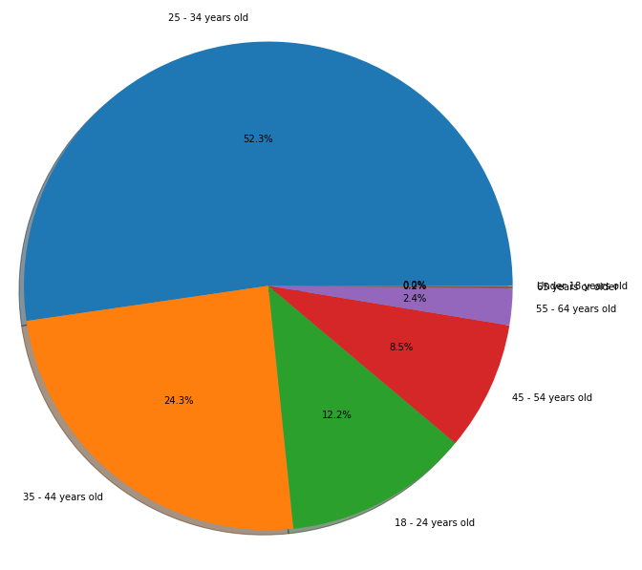
Age
18-24
25-34
35-44
45-54
55-64

Slide 5
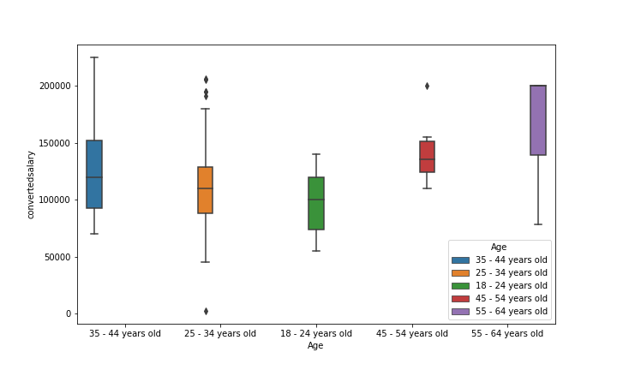
Age

Slide 6
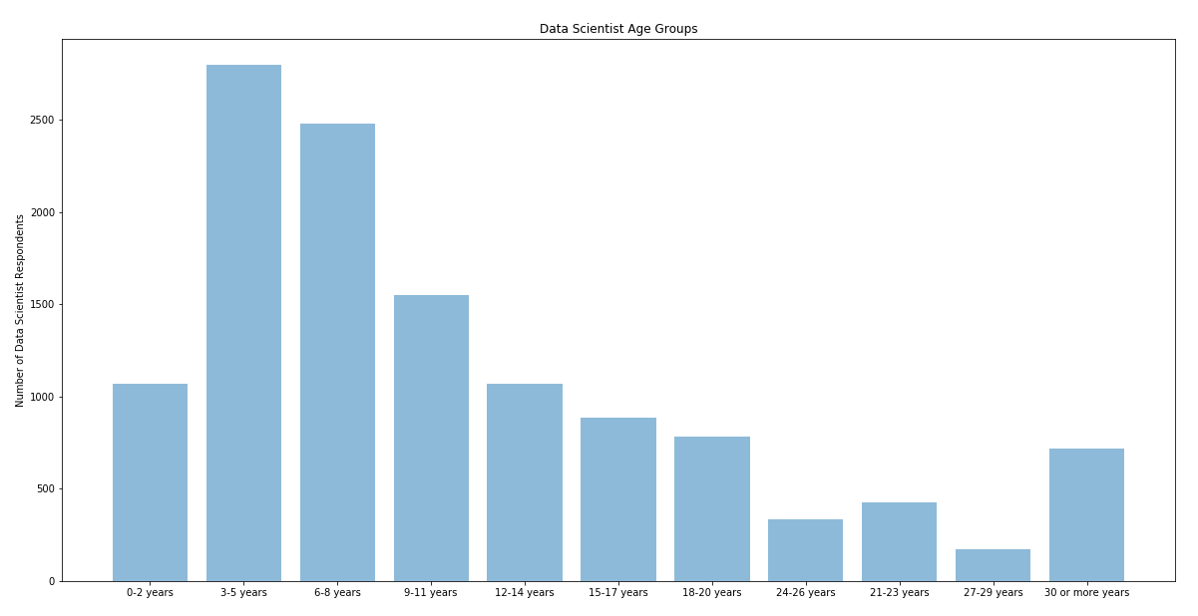
Experience

Slide 7
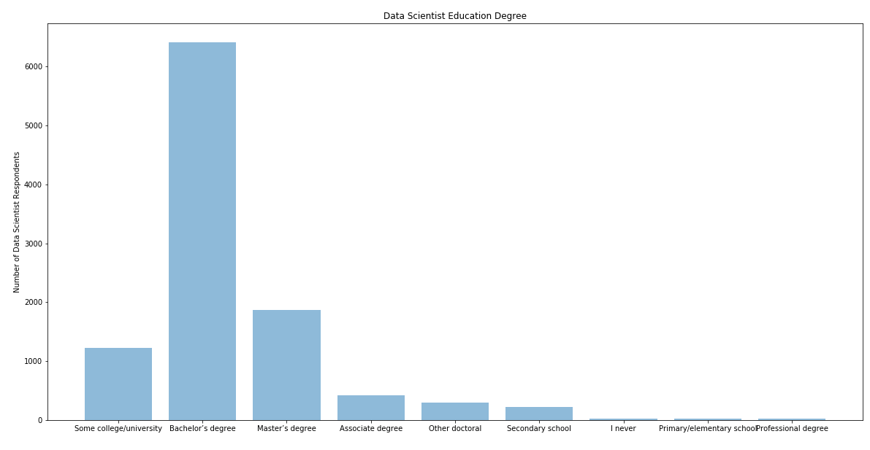
Degree

Slide 8
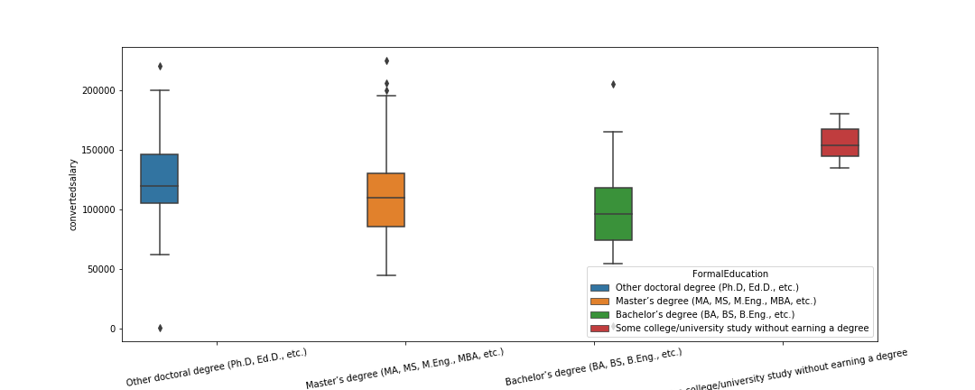
Degree

Slide 9
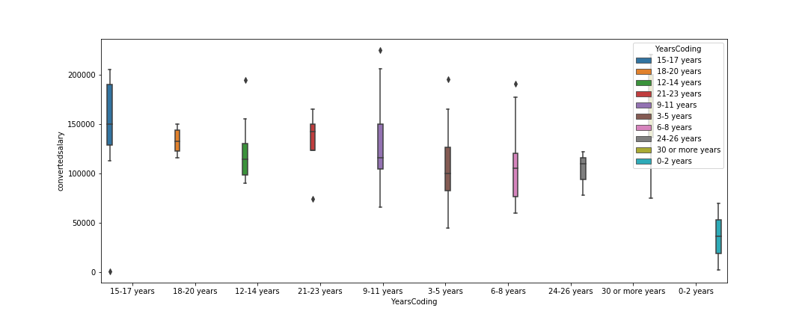
Experience

Slide 10
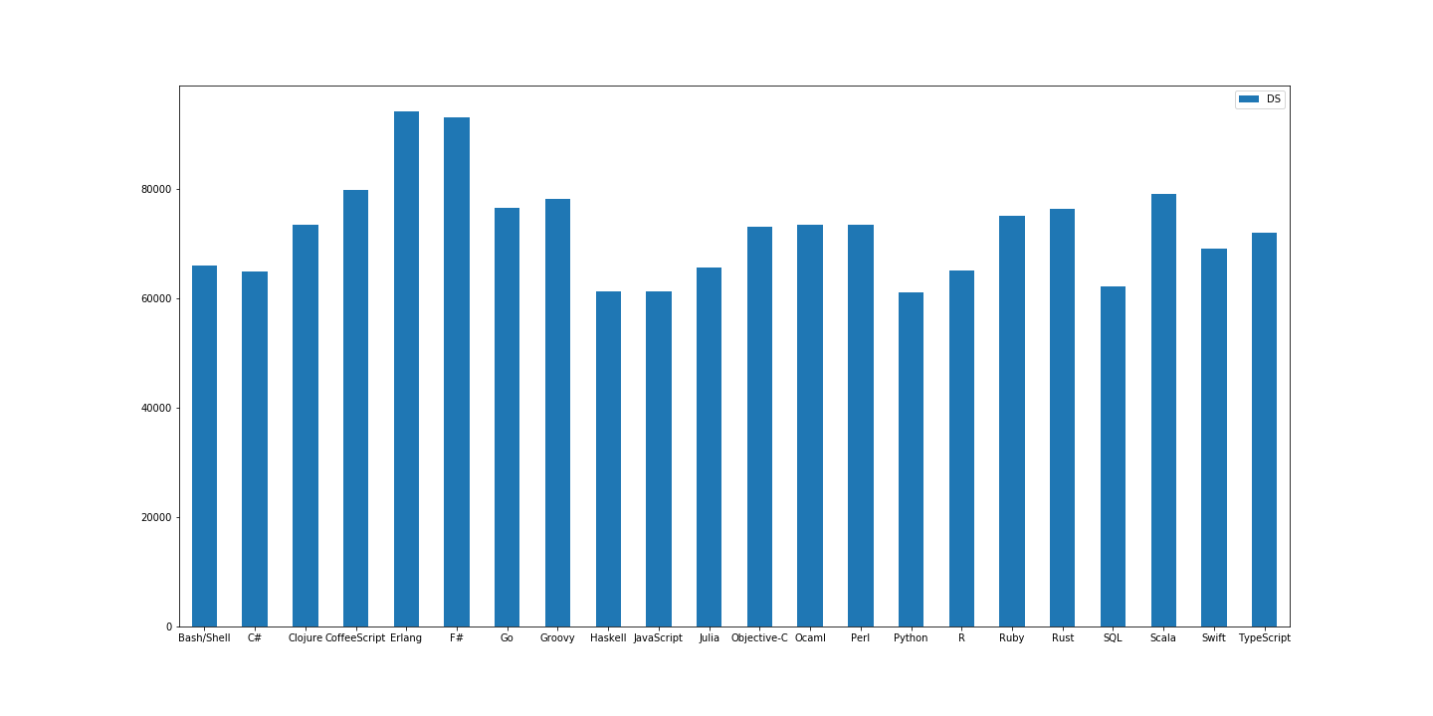
Skills

Slide 11
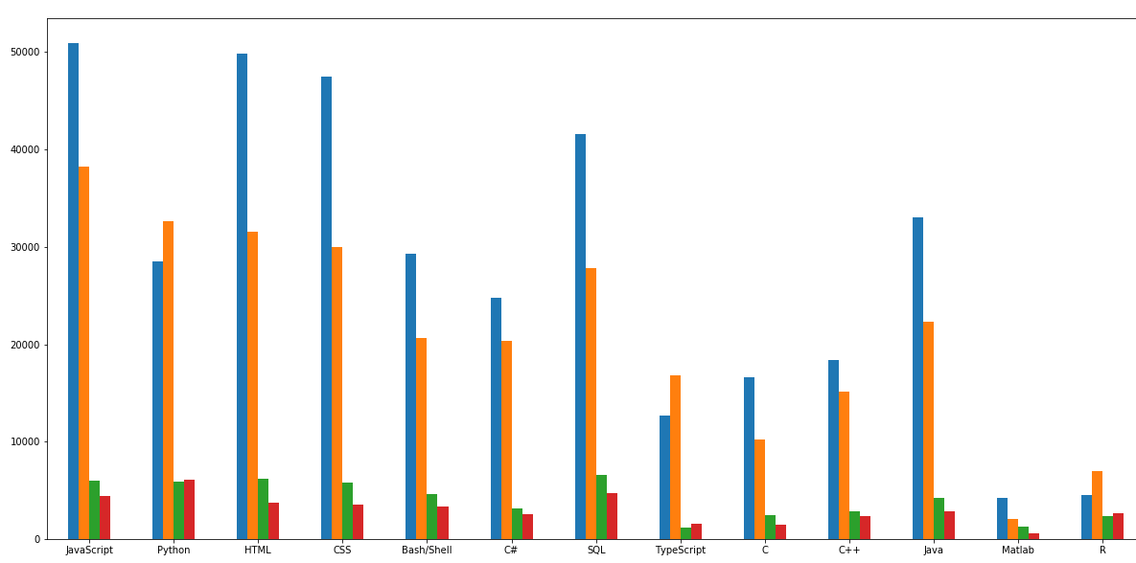
Language Trend

Slide 12
Q & A

